Slide 1
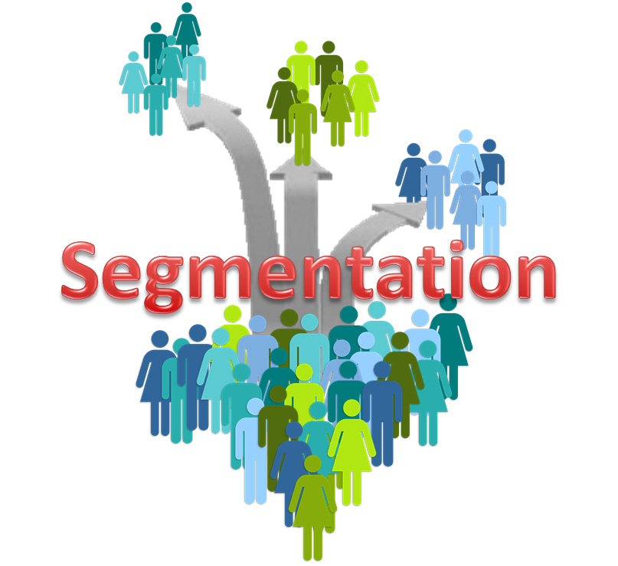
Customer Segmentation
- Using K-means
BY SAURAV BORAH

Slide 2
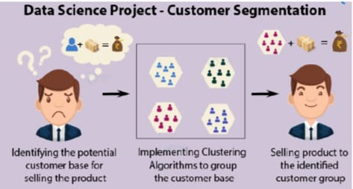
INTRODUCTION TO MAIN PROJECT
The main objective of our project was to use clustering
and to identify segments of customers to target the
potential user base. Then divide customers into groups
according to common characteristics like gender, age,
interests, and spending habits so they can market to
each group effectively.

Slide 3
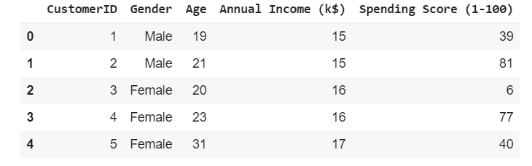
About the Dataset
Companies employing customer segmentation operate under the fact that every customer is different and that their marketing efforts would be better served if they target specific, smaller groups with messages that those consumers would find relevant and lead them to buy something. Companies also hope to gain a deeper understanding of their customers' preferences and needs with the idea of discovering what each segment finds most valuable to more accurately tailor marketing materials toward that segment.
1. CustomerID: It is the unique ID given to a customer
2. Gender: Gender of the customer
3. Age: The age of the customer
4. Annual Income (k$): It is the annual income of the customer
5. Spending Score: It is the score (out of 100) given to a customer by the mall authorities, based on the money spent and the behavior of the customer.

Slide 4
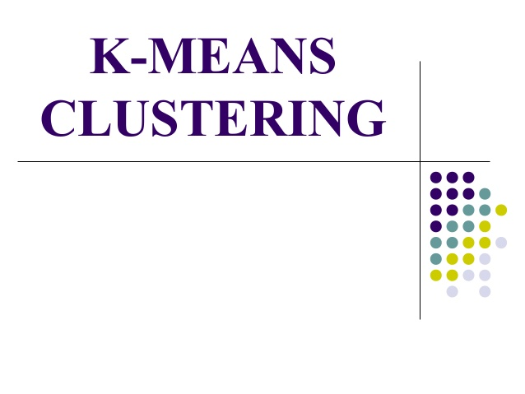
WHAT IS K-MEANS ?
K-means clustering algorithm is the most selected technique to cluster data. K-means is a nonhierarchical clustering and use looping to group data into K groups. The K-means clustering start the iterative process by finding the initial centroid, or central point, of each group by randomly selecting representative data from raw data to be a centroid in each K data groups. Then assign each data to the closest group by calculating the Euclidean distance between each data record to each centroid to allocate the data record to the nearest group. After that each cluster will find new centroid to replace the initial one and repeat steps of Euclidean distance computation to group data members and send each member to group of the nearest centroid. The process will stop when each group has stable centroid and members do not change their groups.

Slide 5
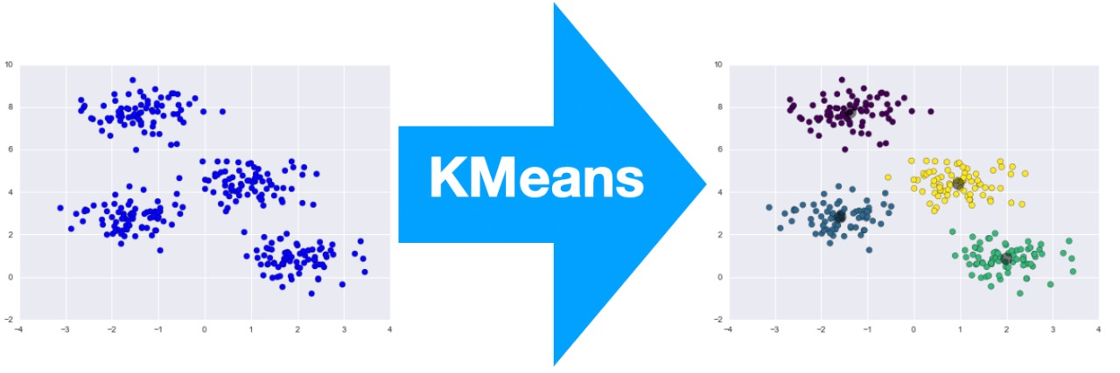
Steps used in a K -means algorithm
The steps of k-means algorithm can be summarized as the following :-
1) Specify group number and select initial centroid of each group.
2) Calculate Euclidean distance for each data member and centroid to assign members to the nearest centroid.
3) Calculate distance’s mean of every data member and own centroid to define new centroid in each group.
4) Repeat steps 2 and 3 until each group has stable centroid or same centroid.

Slide 6
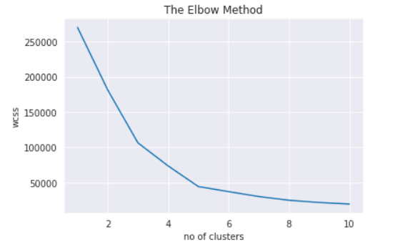
Elbow method for optimal value of k in K -Means
The Elbow method looks at the total WSS as a function of the number of clusters: One should choose a number of clusters so that adding another cluster doesn’t improve much better the total WSS.
The optimal number of clusters can be defined as follow:
Compute clustering algorithm (e.g., k-means clustering) for different values of k. For instance, by varying k from 1 to 10 clusters.
For each k, calculate the total within-cluster sum of square (wss).
Plot the curve of wss according to the number of clusters k.
The location of a bend (knee) in the plot is generally considered as an indicator of the appropriate number of clusters.

Slide 7
TOOLS AND TECHNOLOGIES USED
JUPYTER NOTEBOOK:- The Jupyter Notebook is an open-source web application that allows you to create and share documents that contain live code, equations, visualizations and narrative text.
NUMPY :- NumPy is a library for the Python programming language, adding support for large, multi-dimensional arrays and matrices, along with a large collection of high-level mathematical functions to operate on these arrays.
PANDAS:- Pandas is a software library written for the Python programming language for data manipulation and analysis. In particular, it offers data structures and operations for manipulating numerical tables and time series.
MATPLOTLIB:- Matplotlib is a plotting library for the Python programming language and its numerical mathematics extension NumPy. It provides an object-oriented API for embedding plots into applications using general-purpose GUI toolkits like Tkinter, wxPython, Qt, or GTK+
SEABORN :- Seaborn is a Python data visualization library based on matplotlib. It provides a high-level interface for drawing attractive and informative statistical graphics.
SCIKIT-LEARN :- Scikit-learn is a free machine learning library for Python. It features various algorithms like support vector machine, random forests, and k-neighbours, and it also supports Python numerical and scientific libraries like NumPy and SciPy .

Slide 8
IMPLEMENTATION
Various libraries were imported to manipulate, visualize and modeling data.
Certain components of the data are visualized for better insight.
Selecting the k value for the model.
Model implementation and obtaining the labels.
Plotting the Clusters on as 2D graph.

Slide 9
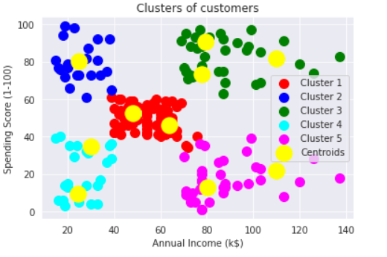
Final graph obtained after the clustering of Customers

Slide 10
Conclusion:
K means clustering is one of the most popular clustering algorithms, and one of the major applications of K means clustering is segmentation of customers to get a better understanding of them which in turn could be used to increase the revenue of the company.
Firstly, we tried to visualize the gender distribution from the given dataset.The female population clearly outweighs the male counterpart. Then we tried to visualize the age distribution. Finally, using the K-means algorithm, we tried to analyze their annual incomes and spending scores.
Based on our machine learning technique we may deduce which clusters of people should be targeted by the mall authorities to increase the profits of the mall, and the clusters of people for who they should maintain their standards to keep the people happy and satisfied

Slide 11


